Slide 1
Coding Dojo Big Data
Session 1/8: Introduction & Kafka Essentials

Slide 2

Introduction
Big Data: 3V
Volume
Velocity
Variety

Slide 3
Introduction
Big Data: 5V
Volume
Velocity
Variety
Veracity
Valence

Slide 4
Introduction
Big Data: 6V
Volume
Velocity
Variety
Veracity
Valence
Value

Slide 5
Introduction
Big Data: 6V
Volume → PetaByte
Velocity → M/second
Variety → Unstructured, Semi-Structured, Structured
Veracity → Source reliability, investigation
Valence → ++
Value → €€€

Slide 6
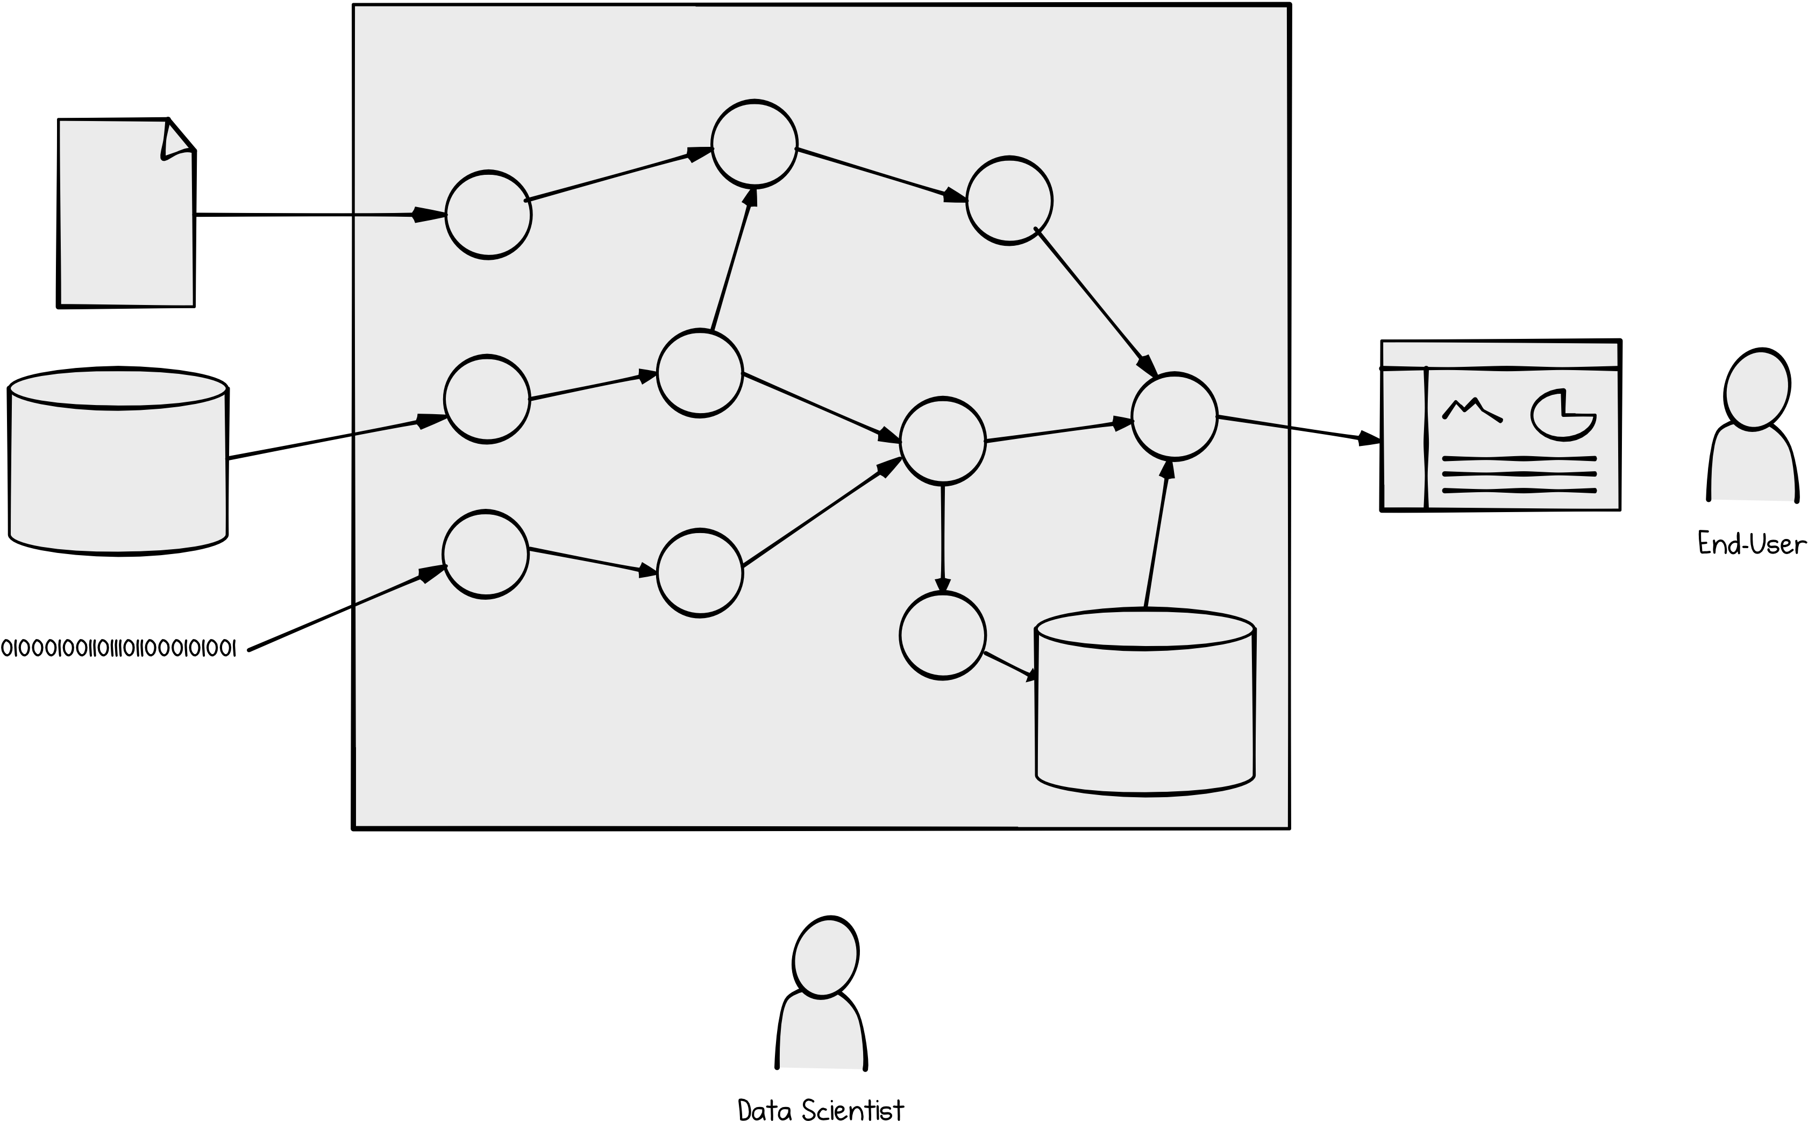
Architecture
General Architecture

Slide 7
Data transport: Kafka
Kafka
Message Bus (Publish/Subscribe)

Slide 8
Data transport: Kafka
Kafka
Message Bus (Publish/Subscribe)
Data store
Data processing
Connect to external systems

Slide 9
Data transport: Kafka
Kafka
Message Bus (Publish/Subscribe)
Data store
Data processing
Connect to external systems
Confluent Schema Registry (Avro)
Guarantees:
Ordering (per partition)
Exactly-once semantics*

Slide 10
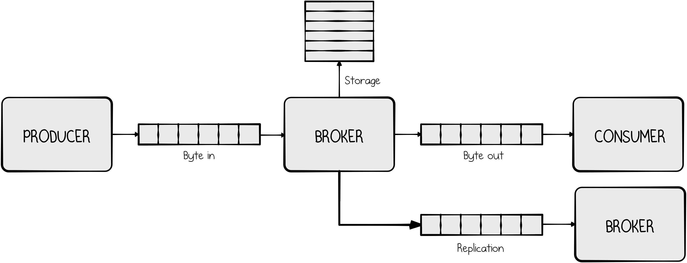
Kafka: Brokers, Producers, Consumers

Slide 11
Message format
Record
Key
Value
Timestamp
Header(s)
Topic
Partition

Slide 12
Kafka: Hands-on
Data
Reference: (user_id, user_name)
Event: (user_id, message)
Producer
Produce records: reference data and events
Consumer
Consume records: reference data and events, then join and display
Unit Tests
Test producer and consumer
JMX
Metrics

